Slide 1
Welcome!
Sunday
Bible Study 9:30 AM
Worship 10:30 AM
Wednesday
Bible Class 7:00 PM
www.SunsetchurchofChrist.net

Slide 2
John 8:21-30
Jesus reveals His goal
Belief in Jesus
Speaking from the Father

Slide 3
Welcome!
Sunday
Bible Study 9:30 AM
Worship 10:30 AM
Wednesday
Bible Class 7:00 PM
www.SunsetchurchofChrist.net

Slide 4
Opening Prayer | Gregor Hinckley
Song – 3 | George Watkins
Scripture Reading | Ryan Sollars
Song – 513 | George Watkins
Song – 172 | George Watkins
Lord’s Supper | Ryan Sollars / Michael Hetzer
Song – 489 | George Watkins
Collection | Ryan Sollars / Michael Hetzer
Song – 416 | George Watkins
Lesson | Brian Haines
Song –524 | George Watkins
Closing | Lamar McDonald

Slide 5
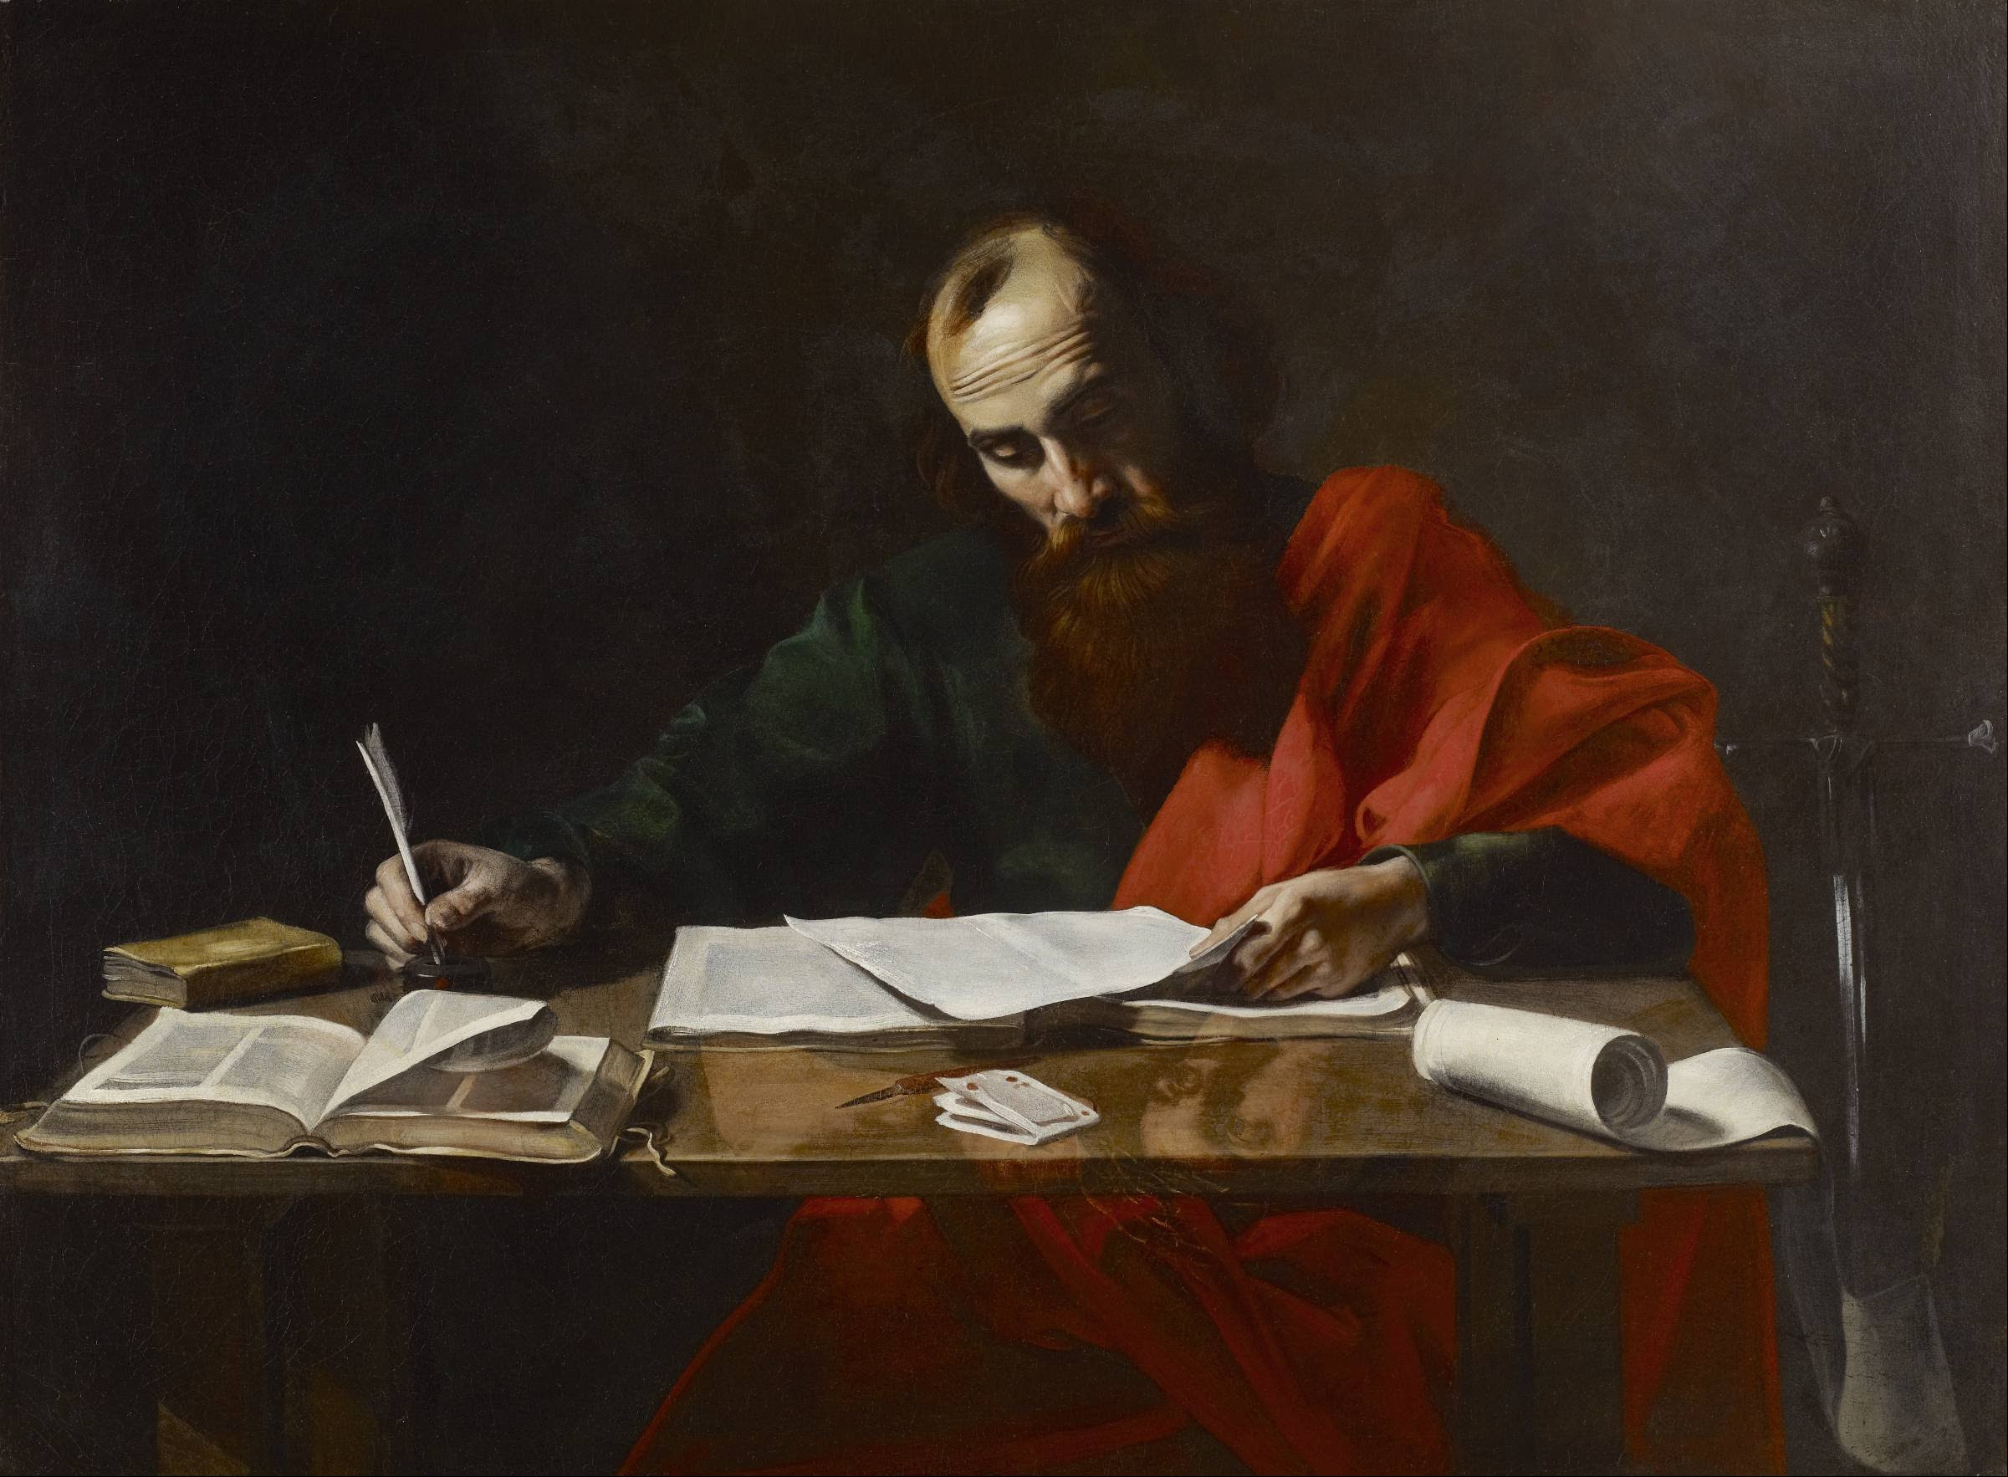
Paul’s Corinthian Advice
1 Corinthians 5
"put away …. the evil person"
Notes:
Begin reading at vs. 15

Slide 6
It Has Been Reported
Is this gossip or a request for help?
1) A matter of reputation
2) A matter of public knowledge
3) A matter of need

Slide 7
It Has Been Reported
“A man has his father’s wife”
Living in fornication?
Married (and living in adultery)?
Are there “levels” of immorality?
There are multiplications of sin

Slide 8
The Apostolic Command
Deliver them to Satan
Vs 11 - “not to keep company”
Rom. 16:17 – “avoid them”
2 Thes. 3:6 – “withdraw from (them)”

Slide 9
The Apostolic Command
Why the absence of Matthew 18?
No command to speak to them?
The nature of a public sin
The nature of a congregational sin

Slide 10
The Apostolic Command
Why must this be done?
1. “that his spirit may be saved”
To get them to repent
2 Thes. 3:14 – “that he may be ashamed”
Notes:
2Th 3:14 And if anyone does not obey our word in this epistle, note that person and do not keep company with him, that he may be ashamed.

Slide 11
The Apostolic Command
Why must this be done?
1. “that his spirit may be saved”
2. “a little leaven leavens the whole lump”
To keep the church preserved
2 Tim. 2:17 – “spread like cancer”
Notes:
2Ti 2:17 And their message will spread like cancer. Hymenaeus and Philetus are of this sort,

Slide 12
The Apostolic Command
Why must this be done?
1. “that his spirit may be saved”
2. “a little leaven leavens the whole lump”
3. “not even named among the Gentiles”
To prevent a name for evil
2 Cor. 8:21 – honorable before men
Notes:
2Co 8:21 providing honorable things, not only in the sight of the Lord, but also in the sight of men.

Slide 13
Outsiders vs. Inside
Outsiders – those in the world
We are permitted relationships
We are very careful in those
They are lost – judged by God

Slide 14
Outsiders vs. Inside
Outsiders – those in the world
Insiders – those in the church
We are obligated relationships
We must get to heaven together
We must make judgments

Slide 15
Therefore
Have the right attitude
Do not desire to put others out
Desire to restore those who are out
Desire the purity of the church
Desparately!

